Slide 1
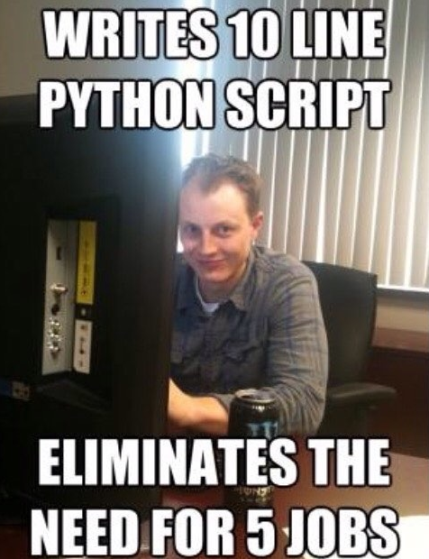

Slide 2
Tips on The lab
Every formula you need is at the top of the sheet
Do the multiplication method then the subtraction method (you’ll use multiplication and addition) to find the subtraction
If you forgot, the sqrt function is in the math module
- “from math import sqrt”
Finally, Please download the provided main.py to test your program
Make sure the python file you create is named “vector.py”

